Slide 1
G-20 GDP recovery post COVID 19-Pandemic
Summary:
Analyzing the GDP recovery of G-20 countries after the COVID-19 pandemic.
Key goal: Identify the most resilient country by GDP using a custom "Resilience Index.“
The analysis focuses on six key factors:
Nominal GDP, GDP per capita, GDP Growth, GDP Expenses, COVID cases, and COVID deaths.
Data visualization includes graphs, choropleth maps, heatmaps, tables, and a country-level dashboard.
Student:
Victor Neves Borges
Professor:
Anupriya Srivastava

Slide 2
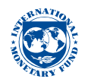

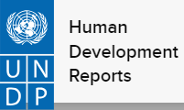

Methodology
Main Points: Data was collected from reliable sources:
IMF: Debt-to-GDP Ratio: https://www.imf.org/external/datamapper/datasets
UNDP: Human Development Data: https://hdr.undp.org/
World Bank: GDP per capita: https://data.worldbank.org/
Our World in Data: COVID cases and deaths: https://ourworldindata.org/covid-cases
Six factors were selected to assess resilience:
Nominal GDP: Overall size of the economy.
GDP per capita: Economic output per person.
GDP Growth: Economic recovery rate.
GDP Expenses: Government spending.
COVID cases and deaths per capita: Health impact of the pandemic.
Resilience Index was calculated by weighting these factors.

Slide 3
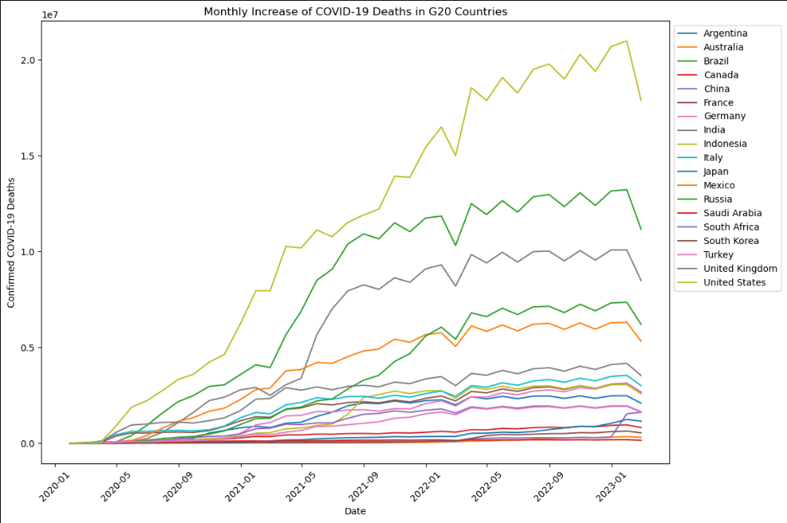
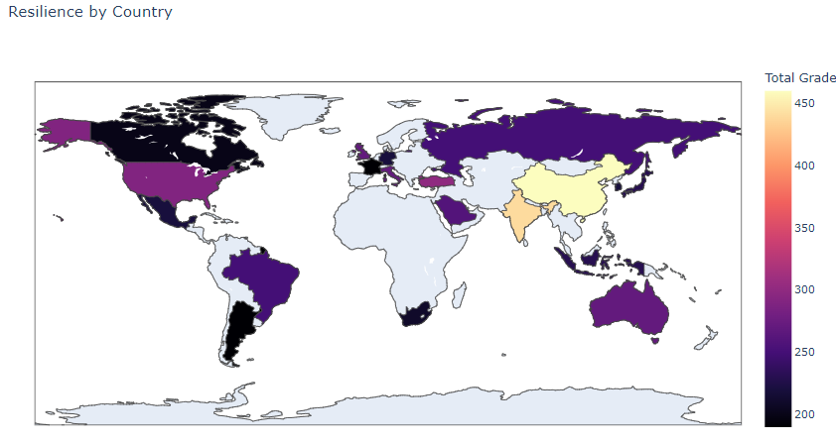
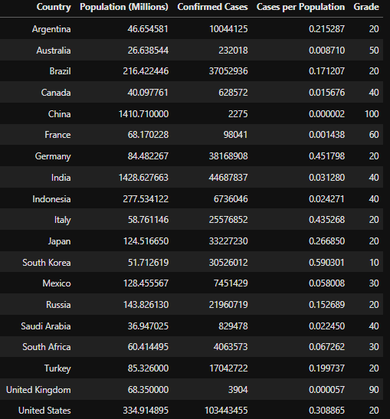
Data Visualization and Key Findings
Main Points:
Each factor was visualized using various techniques:
Graphs: Trend analysis over time for
GDP and COVID factors.
Choropleth maps:
Geographical distribution of resilience.
Tables:
Detailed breakdowns for each country.

Slide 4
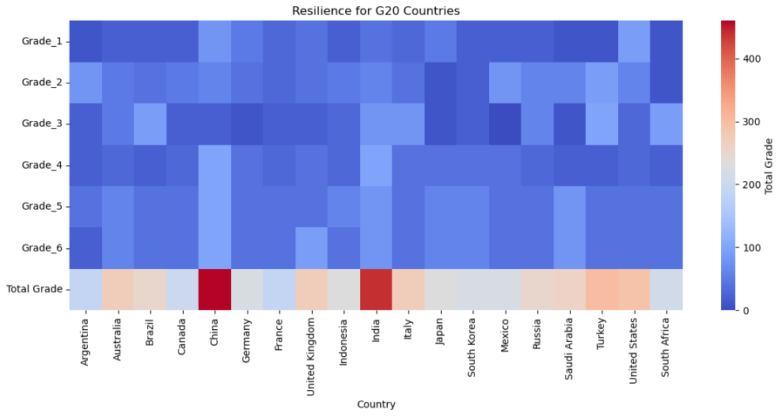
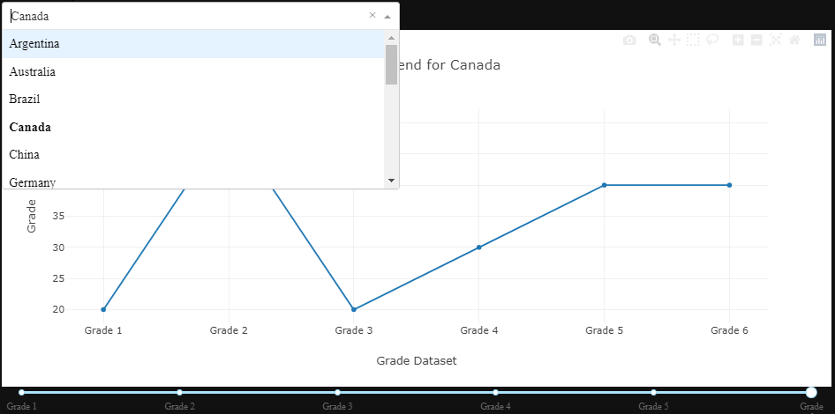
Dashboard and Conclusion
Conclusion: The Resilience Index provides a comprehensive view of how G-20 countries handled the economic impact of the COVID-19 pandemic, with insights on which countries emerged strongest. In this case, China and India were the most resilient of them all
Countries were assigned "Grades" based on their performance in each category.
A dashboard was created to provide an individual analysis of each country based on the six factors.
The dashboard allows interactive exploration of each country's resilience across the criteria.

